Slide 1
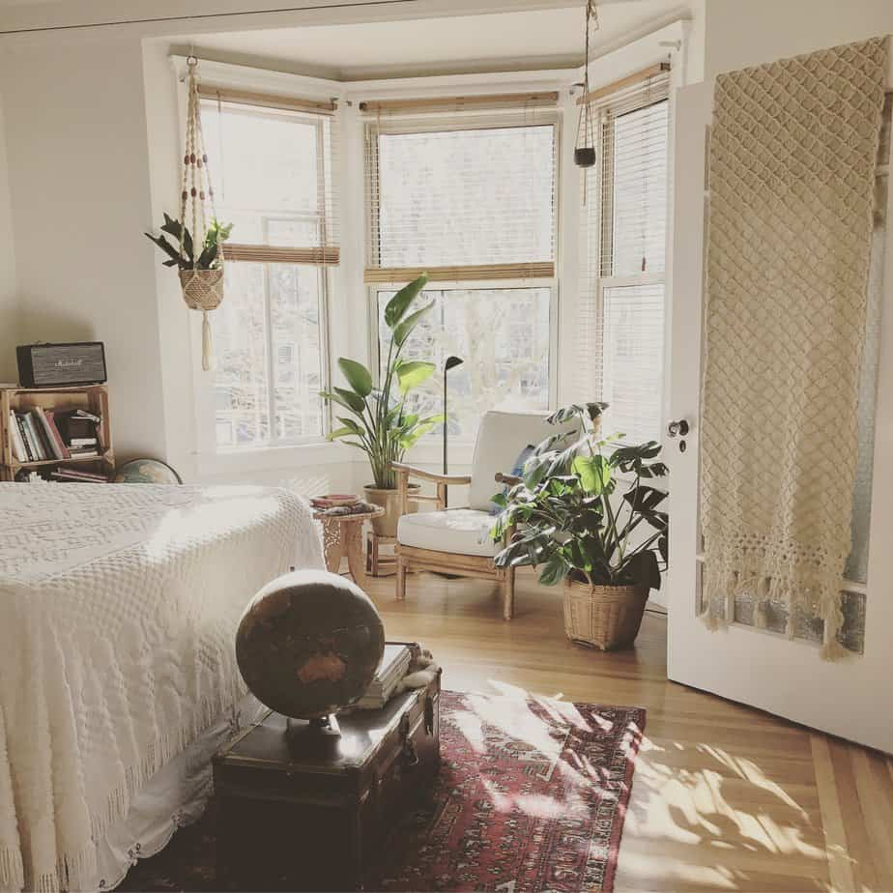
HDB Resale Price
Chai Shu Ying
House is a place that serves as living quarter for one or a few families

Slide 2

URLs of all the dataset
Resale transaction by flat type based on registered cases
https://data.gov.sg/dataset/resale-transaction-by-flat-type-based-on-registered-cases
HDB resale price index
https://data.gov.sg/dataset/hdb-resale-price-index
Resale flat prices
https://data.gov.sg/dataset/resale-flat-prices

Slide 3
Nature of dataset
HDB resale price index
Resale transaction by flat type based on registered cases
Resale flat prices
1
2
3

Slide 4
HDB resale price index
Quarter
every 3 months
Index
the price changes of residential housing as a percentage change from some specific start date
Extract data from 2015 to 2021
4 quarters in a year
Price index is an indicator of overall price movement of public housing

Slide 5
Resale transaction by flat type based on registered cases
financial_year
Financial year starts on 1 April and ends on 31 March
flat_type
Type of flats
resale_transactions
Total number of transactions
Extract data from 2015 to 2020
6 types: 1 room, 2 room, 3 room, 4 room, 5 room, executive

Slide 6
HDB resale price index
month
month
town
town in Singapore
flat_type
flat type
block
block number
street_name
name of the street
storey_range
floor levels
floor_area_sqm
floor area in square meter
flat_model
flat model
lease_commence_ date
the date where leasehold tenure starts
remaining_lease
a limited period remaining on their lease, depending on their age
resale_price
a price to be charged on a resale
Extract data from 2015 to 2022
Filter out all 4-room flat type
Categorize storey range into 5 different categories.

Slide 7
Problem statement
A young couple would like to buy a flat.
They have a budget of $500,000 for the house.
What are the factors that would affect the resale price?

Slide 8
Highlights
This assignment will focus on the data starting from the year 2015.
This is because the column of the remaining lease (resale price) is only available from 2015 onwards.
Therefore, all datasets will be filtered out accordingly as a standard.

Slide 9
Graph
1
Line graph - resale price index
2
Bar chart – sum of resale transaction
3
Steps
Of plotting those graphs
Bar chart – average of resale transaction
4
Boxplot – resale prices of 4 room flats in different town (further break down to the floors)
5
Scatterplot – price per sqm vs floor area
6
Scatterplot – price per sqm vs remaining lease

Slide 10

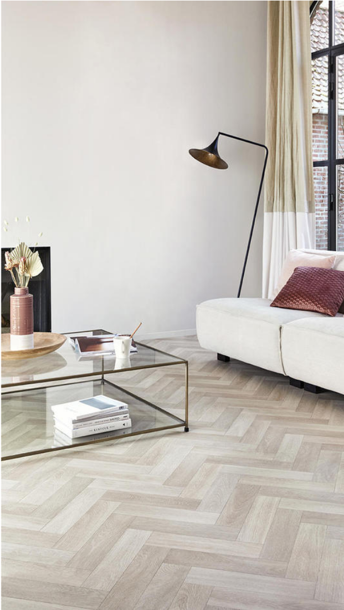
Understand
the
steps
Resale Price Index
Using np.genfromtxt() to read the file type from hdb resale price index, skip header, replace missing values with 0.
Use isin() to extract rows that contain keywords (include data from 2015 to 2021).
Print out total rows and columns in the dataset.
Print out all the unique values in the quarters.
Print out all the unique values in the index column.
Use np.argmax() and np.argmin() to find highest and lowest resale price index in the quarter(year) and print it.
Plot x,y by using values from quarters and index.

Slide 11
Understand
the
steps
Resale transactions
by flat type
Sum of resale transaction
Using np.genfromtxt() to read the file type from hdb resale price index, skip header, replace missing values with 0.
Use isin() to extract rows that contain keywords (include data from 2015 to 2020).
Print out total rows and columns in the dataset.
Print out all the unique values in each column. (financial year, flat type and resale transactions)
Use np.argmax() and np.argmin() to find highest and lowest number of transactions for a flat type in the year.
Use for loop with np.sum() function to collect and find the sum of resale transaction for each flat type .
Use OrderedDict () to sort the bar chart to be displayed in the descending order.
Plot the graph (plt.bar()) by using sum values from the calculation.
Style the graph for easy understanding.

Slide 12
Understand
the
steps
Resale transactions
by flat type
Average of resale transaction
Using np.genfromtxt() to read the file type from hdb resale price index, skip header, replace missing values with 0.
Use isin() to extract rows that contain keywords (include data from 2015 to 2020).
Use for loop with np.average() function to collect and find the average of resale transactions for each flat type.
Use OrderedDict () to sort the bar chart to be displayed in the descending order.
Plot the graph (plt.bar()) by using average values from the calculation.
Style the graph for easy understanding.

Slide 13
Understand
the
steps
Resale prices of 4 room flats in different town (further break down to the floors)
Resale price
Read file using np.genfromtxt() skip header, replace missing values with 0.
Use np.isin() to filter out data that contains 4 room flats.
Break down the data into 4 categories based on floors.
Cat 1 - L1 to L12
Cat 2 - L13 to L14
Cat 3 - L25 to L36
Cat 4 - L37 to L51
Assigning parameters to the prices of the 4 room flats according to their towns.
Further breakdown the parameters to the floors of the 4 room flats.
By using ax.boxplot(), plot the first box plot with all floors inclusive, followed by the 4 categories individually.
Style the graph for a better understanding.

Slide 14
Understand
the
steps
Price per sqm (4-room) vs floor area
Resale price
Read file using np.genfromtxt()
Use np.isin() to filter out data that contains 4 room flats.
Extract out floor area and resale price from the filtered data.
Use resale price divided by floor area to find the price per square meter (sqm)
Plot using scatter plot, plt.scatter()
Draw a regression linear line to show positive/negative association.

Slide 15
Understand
the
steps
Price per sqm vs remaining lease
Resale price
Read file using np.genfromtxt()
Use np.isin to filter out data that contains 4 room flats.
Use remaining lease ,floor area (sqm) and resale price from the filtered data.
Filter out only year without month from the remaining lease column.
Covert the dtype of remaining lease from string to integer.
Using resale price / floor area to find the price per square meter (sqm).
Plot a scatter plot using remaining lease and price/sqm.

Slide 16
Graph
1
Line graph - resale price index
2
Bar chart – sum of resale transaction
Bar chart – average of resale transaction
Analysis
3
Boxplot – resale prices of 4 room flats in different town (further break down to the floors)
4
Scatterplot – price per sqm vs floor area
5
Scatterplot – price per sqm vs remaining lease

Slide 17
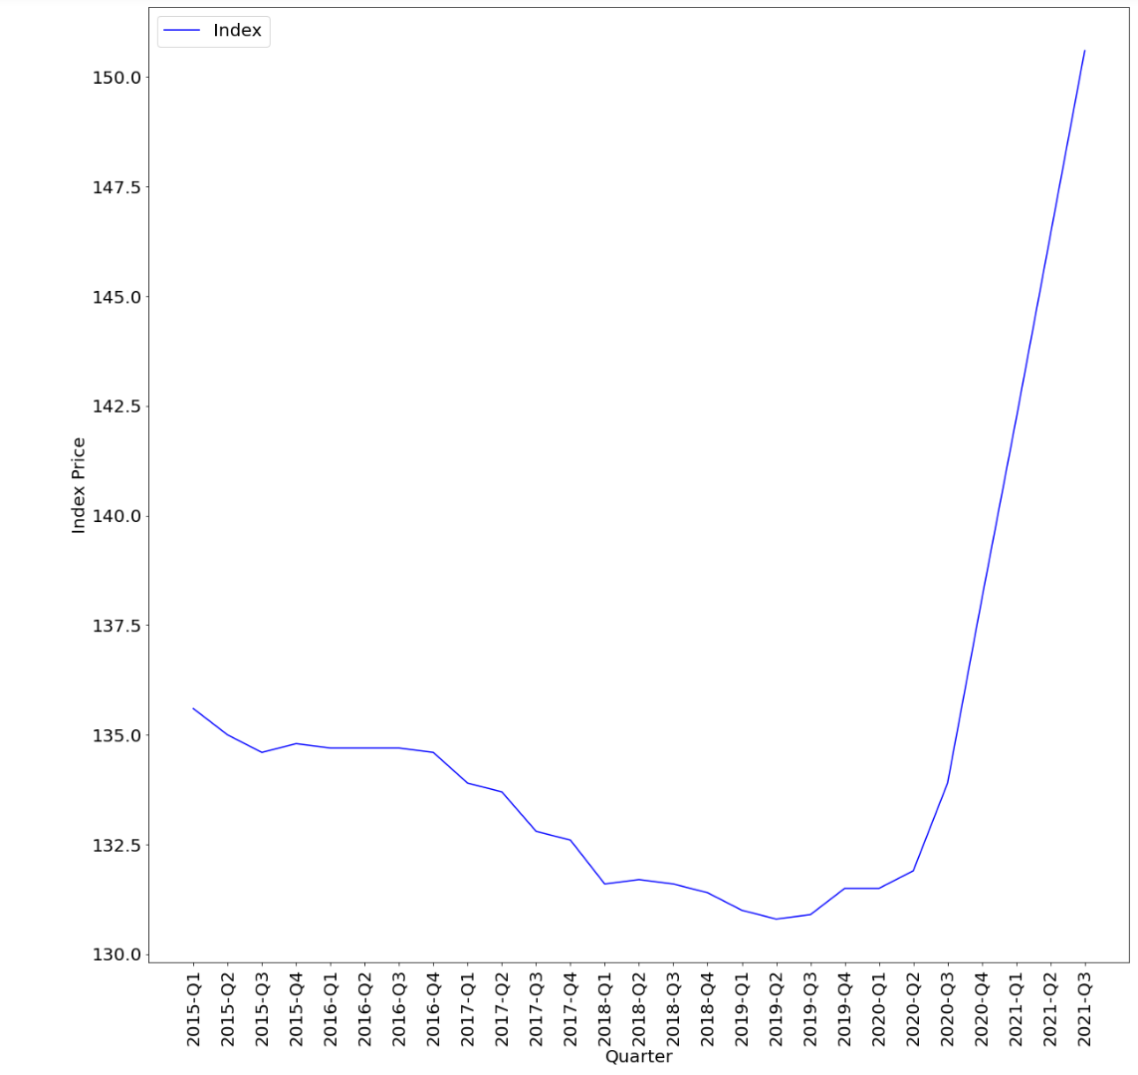
1

Slide 18
From the graph, 2015(Q1) to 2019(Q2) , index price has been dropping constantly.
From 2020(Q2) the index price suddenly spiked to 150.6 on 2021 (Q3).
During 2019, covid started. CNA announced that the BTO projects will be delayed. From 2020, the resale price index spiked because of the news, potential BTO bidders turn to resale market instead.
Home owners turn to the resale market due to various reasons such as long wait time for current BTO and bigger housing size for older estate. For home buyers that are affected by the construction delay due to Covid-19 outbreak, Ministry of National Development (MND) recognises the frustration and HDB will consider waiving the forfeiture based on the assessment of the homeowners. If the buyers are successful in their appeal, HDB will waive the financial penalty and one year wait out period for these homeowners. These homeowners can choose to look for a home in the resale market if they are urgent in building a family. High amounts of grants up to $160,000 for purchasing a resale flat also led to the high price index of the resale market.
ANAYSIS

Slide 19
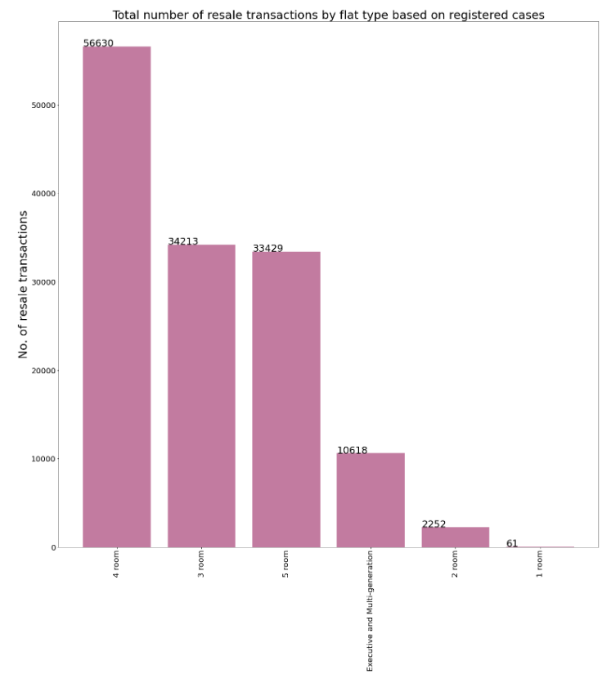
2

Slide 20
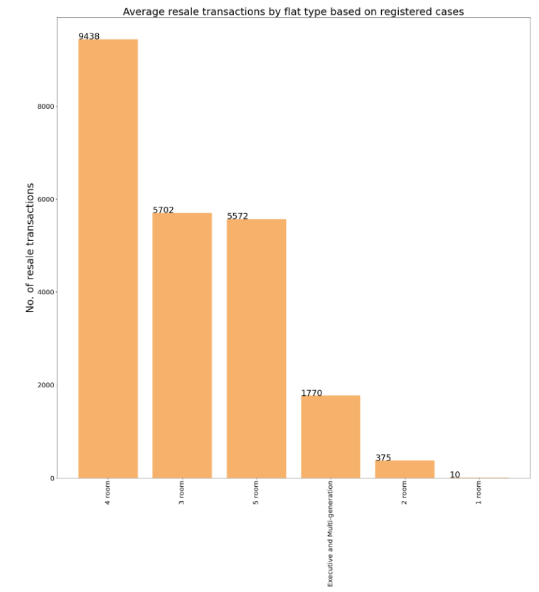
2

Slide 21
The total number of transactions from 2015 to 2020 is 137,203.
Out of which 41% (56,630) are 4-room flat, 25% (34,213) 3-room, 24% (33,429) 5 rooms, 10% others.
The average resale transaction for the 4-room flat is 9438, 5702 for 3-room, 5572 for 5-room and others.
Based on the above graphs, we can tell that a 4-room flat is the most transacted flat type in the resale market.
4-room flat could be the most preferred flat type among all the potential homeowners in Singapore.
On a side note, according to the CNA article, more extensive HDB resale flats have become more popular. The average quarterly transactions went up from 18% for smaller HDB resale flats but rose about 34% for larger ones during the covid-19 period. Work-from-home becomes a norm and more employers are more flexible with the work arrangement, therefore potential homeowners eye on larger homes.
ANAYSIS

Slide 22
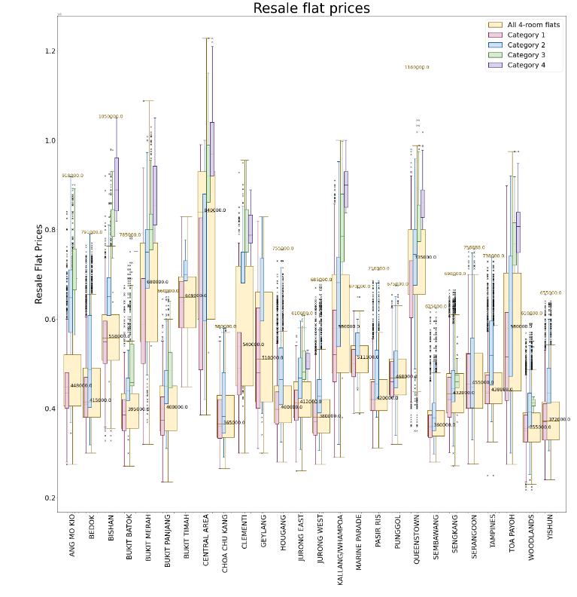
3

Slide 23
Since 4-room flat is the most transacted flat type in the resale market based on the previous graph plotted, the following analysis is done mainly based on this flat type. This could
represent the HDB resale price pattern as a whole.
Based on the box plot, the highest median resale flat price is in the Central Area, with $840,000. Whereas the lowest median resale flat price is in Woodlands, with $350,000. Queenstown resale flat price has the highest volatility among the rest, with resale flat prices reaching $1,160,000.
As high floor flats does not necessarily equate to higher resale flat prices in Singapore. After plotting the box plot, Bishan shows that flats in Cat 3 and Cat 4 have prices that are able to match even the Central Area prices. Some areas such as Jurong east, Woodlands and Sembawang which are in Non-mature estate, the high floor units do not equate to high resale flat prices.
The estate town of the flat in comparison to the different floors categories, the estate town has a higher impact on the resale flat prices in general.
ANAYSIS

Slide 24
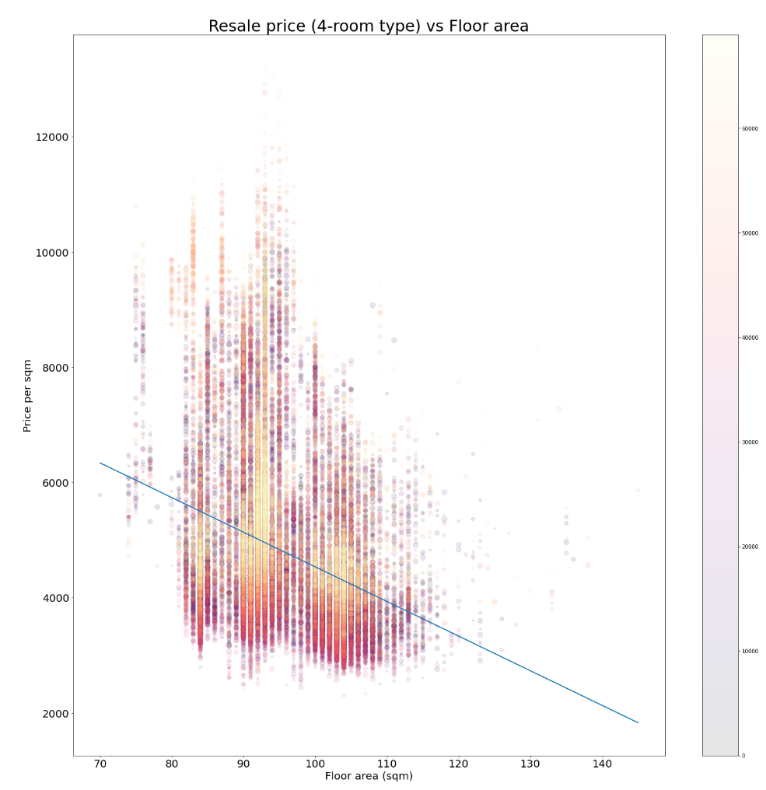
4

Slide 25
As we all know, the bigger the house , the more expensive it is.
However, this is not the case for price per square meter basis.
Using the regression linear graph, I conclude that the smaller the floor area, the higher the price/sqm. The higher the floor area, the lower the price/sqm.
For flat size ranging from 80sqm to 110sqm, prices are mostly in the $4000-$6000/sqm range.
However, there are few exceptions that reach up to $12,000/sqm for flat size ranging 90sqm to 100sqm. There are also a few exceptions that are in the $2000-$4000/sqm range for flat sizes above 120sqm.
ANAYSIS

Slide 26
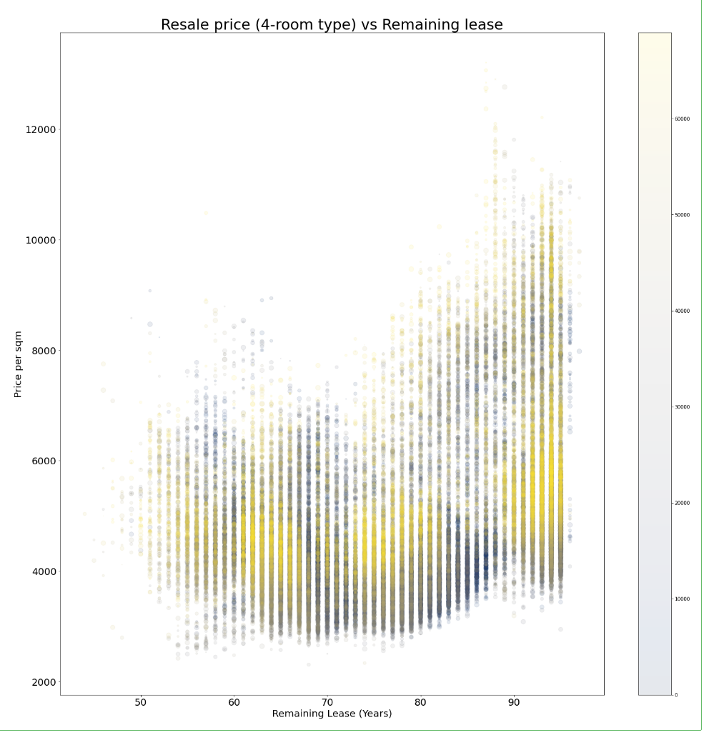
5

Slide 27
Resale flats with 90 years of remaining lease and above will fetch up to $12,000/sqm.
Resale flats with 50-80 years of remaining lease and above will fetch prices ranging from $4000-$6000/sqm.
For flats reaching the MOP of 5 years, the prices can surge up to above $10,000/sqm, however, the prices will decline gradually after the 80 years of remaining lease.
There are some exceptions to sales of properties before Minimum occupation period (MOP) of 5 years in the graph. These might due to unforeseen circumstances such as bankruptcy or divorce.
Some exceptions are that some resale flats will fetch prices less than $4000/sqm.
ANAYSIS

Slide 28
As 4 room flats are the most amount of transacted flats in Singapore, it will be easy for them to find a flat.
1
Their budget of $500,000 will be able to afford a flat ranging from L1 to L24 in a non-mature estate such as Woodlands, Sembawang and Jurong as the flats in these areas do not have high prices for higher floor units.
2
Recommendation
The couple can look for a flat with about 90sqm, which will range about $4000-$6000/sqm and 80 years remaining lease. With HDB grants, the couple can get up to $160,000 worth of grants which will help them find their perfect home.
The couple will not be able to afford a 4-room flat in a mature estate such as Queenstown, Bukit Merah or Central Area.
4
3

